Slide 1
OS Metrics
Diagnosing System performance

Slide 2

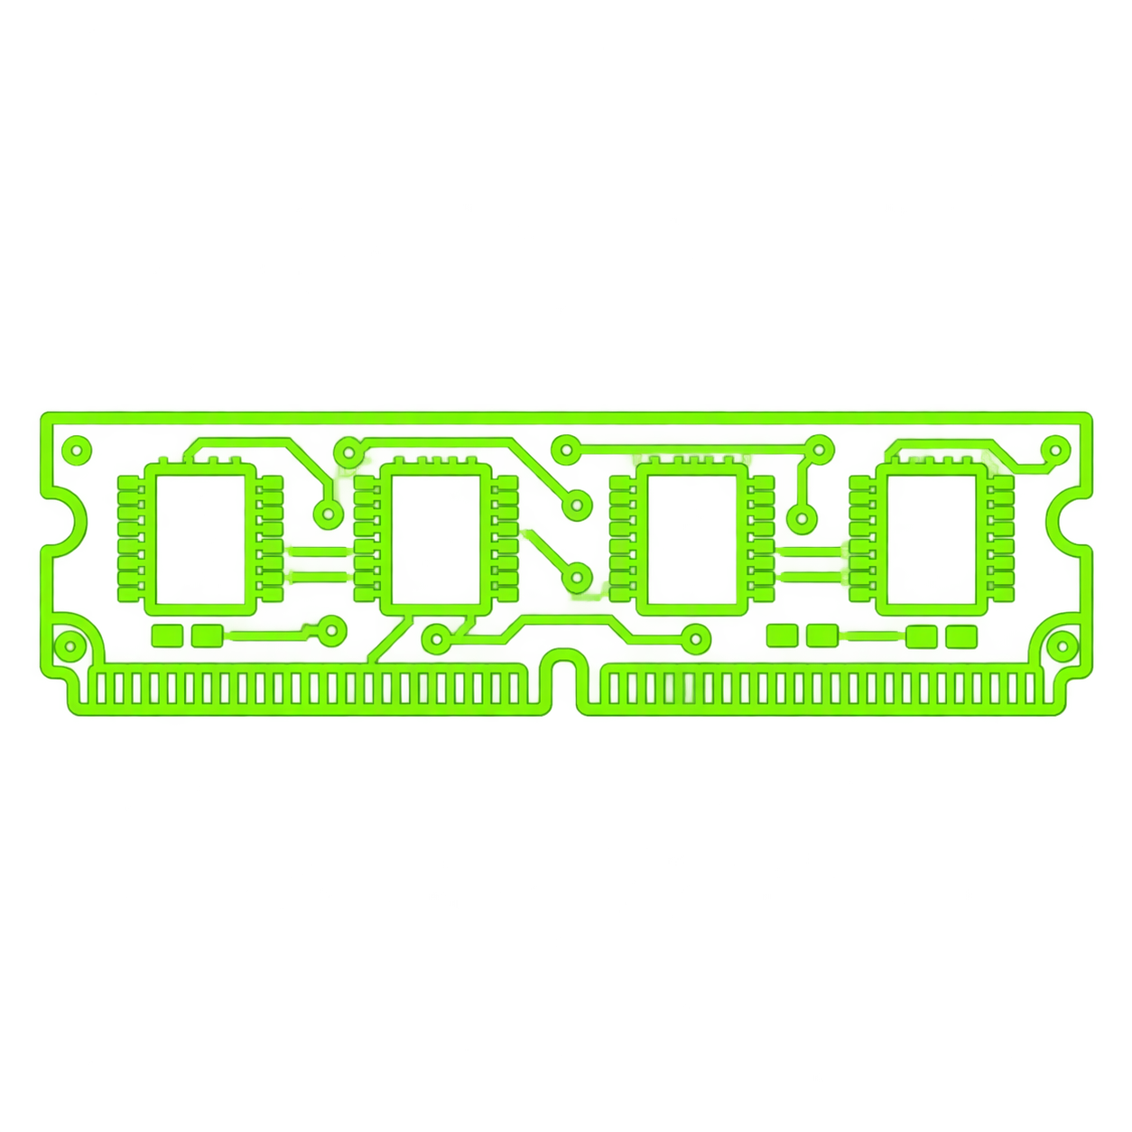


Basic Metrics
CPU Measures how much processor capacity is actively in use.
USE Spot compute bottlenecks, runaway processes, and demand spikes.
MEMORY Tracks RAM used by applications, cache, and the operating system.
USE Detect memory pressure, swapping, leaks, and capacity needs.
DISK Shows storage activity through throughput, latency, and queue depth.
USE Find slow I/O, overloaded drives, and storage bottlenecks.
NETWORK Measures traffic volume, latency, errors, and dropped packets.
USE Diagnose congestion, packet loss, and connectivity issues.

Slide 3




Saturation Patterns
CPU SATURATION Runnable work is waiting because all processor cores are busy.
USE Confirm with sustained high CPU and a growing run queue or load.
MEMORY SATURATION Available RAM is exhausted, forcing paging or aggressive reclaim.
USE Look for low available memory, swap growth, and page-fault spikes.
DISK SATURATION I/O requests arrive faster than the storage device can complete them.
USE Watch for high latency, long queues, and continuous device busy time.
NETWORK SATURATION Traffic approaches link capacity or overwhelms the network path.
USE Correlate throughput plateaus with latency, drops, or retransmits.

Slide 4
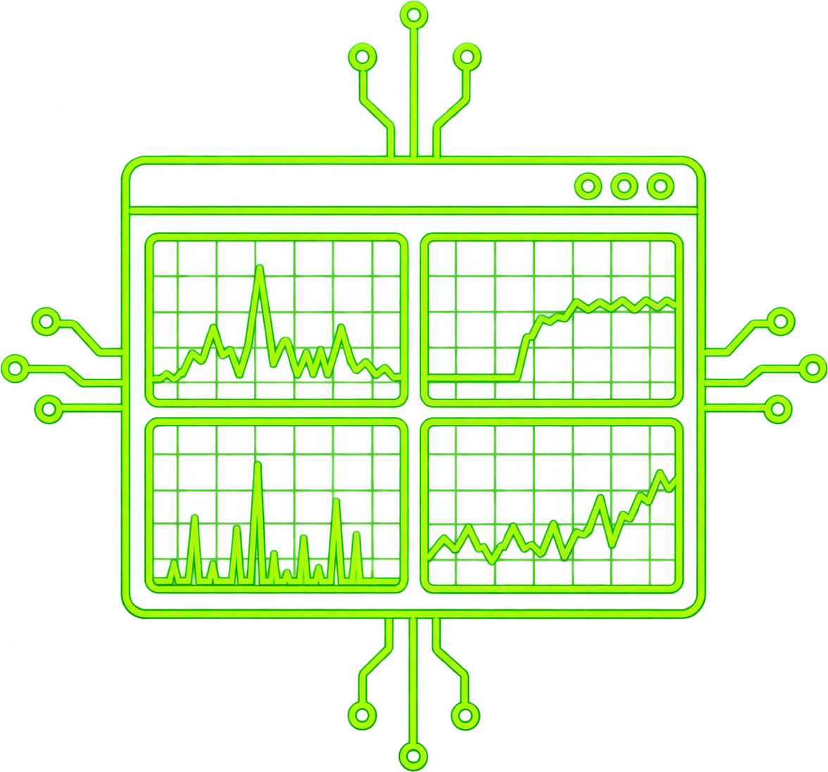
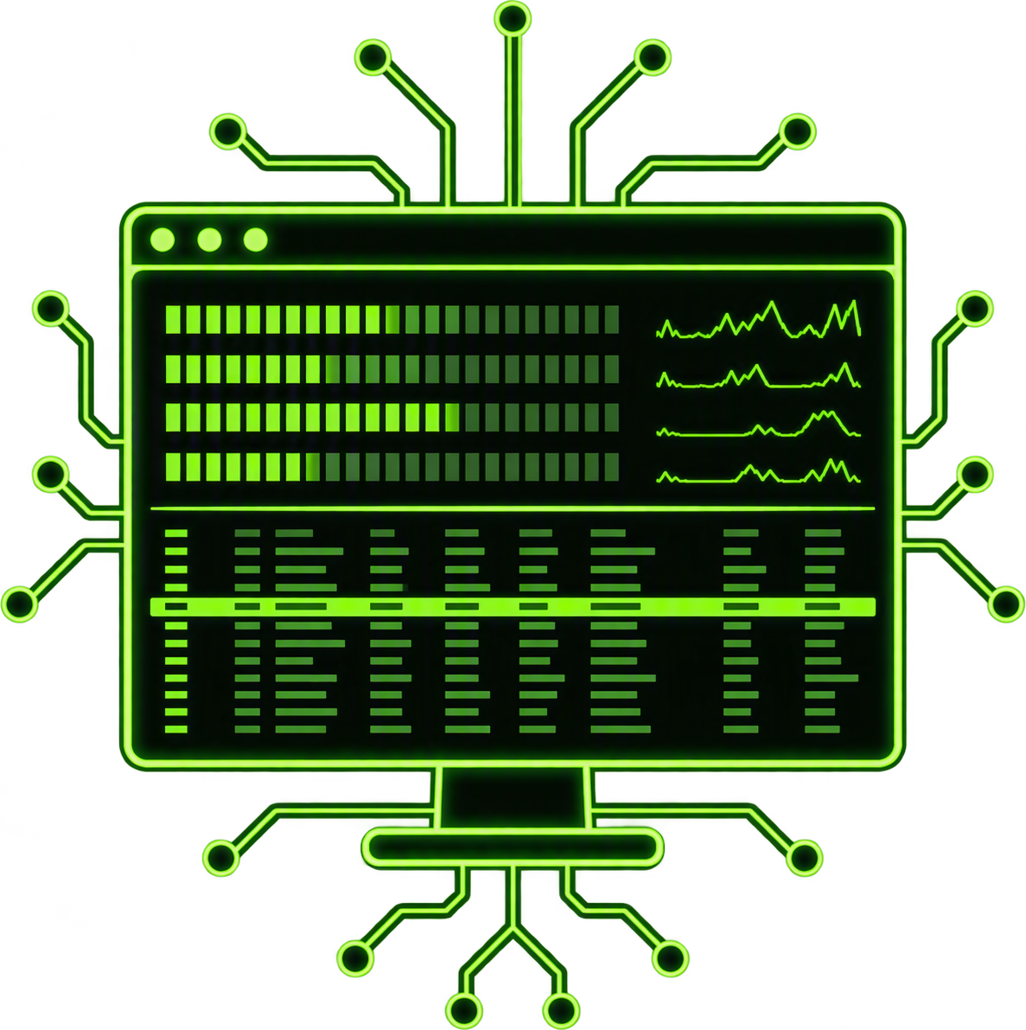


Monitoring Tools
TASK MANAGER
WINDOWS
Graphical overview of CPU, memory, disk, and network
TOP / HTOP
LINUX
Real-time command-line monitoring of resource usage
PERFMON
WINDOWS
Advanced tracking of detailed performance counters
IOSTAT
LINUX
Disk I/O statistics

Slide 5
CPU Utilization vs. Load Average
CPU UTILIZATION
LOAD AVERAGE
0–100% CAPACITY USED
1 / 5 / 15 MINUTES
MEASURES Time the CPUs spend doing work instead of idling.
BEST FOR Confirming how much processor capacity the test consumes.
WATCH OUT An average can hide one hot core—and it does not show queued work.
MEASURES Runnable plus uninterruptible tasks, averaged over time.
BEST FOR Revealing sustained demand and work waiting to run or complete I/O.
WATCH OUT Compare with logical CPU count; on Linux, load is not CPU-only.
READ THEM TOGETHER
CPU % ↑ + LOAD ↑
CPU contention / queueing
CPU % ↔ + LOAD ↑
Investigate I/O or blocked work
CPU % ↑ + LOAD ↔
Busy, but little accumulated queue
WHY IT MATTERS Utilization shows consumption; load reveals contention. Correlate both with throughput and response time to find the saturation point and separate CPU pressure from I/O pressure.

Slide 6
Memory Consumption vs. Memory Leak
HEALTHY CONSUMPTION
MEMORY LEAK
RAMP → PLATEAU
CONSTANT ↑
WHAT IT IS Memory actively used for workload, caches, buffers, and runtime overhead.
EXPECTED Growth follows concurrency or data volume, then stabilizes within capacity.
RECOVERY After load falls or collection runs, usage returns toward a repeatable baseline.
WHAT IT IS Memory remains referenced even though the application no longer needs it.
WARNING Usage keeps climbing under steady workload; each cycle starts from a higher baseline.
IMPACT More collection, longer pauses, paging, instability, and eventual out-of-memory failure.
PROVE IT UNDER TEST
01 HOLD LOAD STEADY
If memory still climbs while throughput is flat, suspect retention—not demand.
02 CHECK RECOVERY
Compare the same post-warm-up checkpoint after load drops and collection completes.
03 CORRELATE SIGNALS
Use working set, committed/heap size, GC rate, and retained-object evidence together.
BOTTOM LINE High usage is normal if it stabilizes and recovers; a leak keeps raising the post-cycle baseline.

